Slide 1
Product Design
Name: …………………………..…… Form…………
Target Grade:
Teacher: Miss Swinburne
Controlled Assessment Support Booklet
Controlled Assessment Section | Marks | Submission Deadline
Investigating the Design Context | 8 | Tuesday 2nd June 2015
Development | 32 | Tuesday 14th July 2015
Making | 32 | Tuesday 15th Dec 2015
Testing & Evaluation | 12 | Tuesday 9th Feb 2016

Slide 2
Specification
Research and Initial Ideas
P
P
8
I
I
N
N
Modelling
Development
P
P
32
I
I
N
N
Final Design and Plan of make
Making
P
P
32
I
I
N
N
Testing of your product
Testing and Evaluation
P
P
12
I
I
N
N

Slide 3
Context: Designer Influences
The work of a specific artist/designer/ or Art/Design Movement could be the source of ideas for a new range of products aimed at a design-conscious consumer market. When completing the task you should ensure that the designs developed into prototypes are not copies of existing work but reflect the general style of the chosen source and might be viewed as “in the style of..”.
Design Task 3
A mail order company wishes to offer a range of products based upon 20th century design movements. You are required to choose one such movement and to design and make a MP3 docking station which reflect the essential features of the movement.
You will need to investigate a specific target market.
Moderator’s Report
- MP3 docking stations were popular once again this year and there were many good examples, but centres approaches to this task are often formulaic with many simply relying on laser cut components.
- Moderators saw a broad range of quality outcomes but candidates are not always addressing the commercial aspects of their chosen product and there is an occasional lack of consideration of the client’s needs.
- Better candidates attempted to make their products more commercially viable through the use of packaging, advertising and point of sale display, for example.
Your MP3 player must fit into a standard shoe box
It must be smaller than 360 mm long, 250 mm wide and 130 mm high.
It will be battery operated with a AUX IN 3.5mm jack lead to connect to music source.
You will need to decide if it is for a certain phone model or universal (can fit various models)

Slide 4
HELP – Section 1 - Investigating the Design Context (8 Marks)
PAGE 1 – Investigating the Design Context
A Design Brief is set by a client and is the starting point for any designer. Copy your chosen Design Brief / Design Task onto this page.
Task Analysis - Once designers have received the Design Brief, they need to work out what needs to be done to respond to the particular brief.
This is called the Task Analysis. Complete a detailed mind map
Important Features Highlight the keywords that you think are important in the context and design brief. Write a sentence about each word to explain why you think it is important.
Conclusion - Write 3 bullet points that you will focus on for your research.
PAGE 2 – Initial Research
Look back at the brief, task analysis and plan what research you need to carry out. Complete the chart – Use the headings – Existing Products, Product Analysis, Mood Board, Target Market
(You might want to change the pieces of research you would like to do, but need 3-4 good pieces).Use your research planning chart and complete research on existing designs from various shops to guide you towards your own design ideas.

Slide 5
Investigating the Design Context P1
Copy the context task into this box
Context
Copy the design brief / task into this box
Design Brief
Create a mind map to analyse the brief and task set
Use these headings for your mind map to help you – Target market, client/company, theme, function,
Aesthetics (how it looks), Environment, components
You may wish to use bubbl.us for this
Highlight the keywords in your context and design brief.
I have highlighted the word…………….
In the design brief because…………….
Important Features
………………
………………
……………
……….
Task Analysis
………..
Write 3 bullet points that you will focus on for your research
I will focus my research on……..
I will focus my research on……..
I will focus my research on……..
……………..
Conclusion
……………
…………………
Notes:
A Design Brief is set by a client and is the starting point for any designer. Copy your chosen Design Brief / Design Task onto this page.
Designing starts with the design brief! Someone gets an idea for a new product.
They decide to employ a designer to work on the idea.
The person who hires the designer is called the client.
The client gives the designer the design brief.
The design brief is a starting point for the development of the product.
It should include: what kind of product is needed, how the product will be used and who the product is for (the target market)
Task Analysis
Once designers have received the Design Brief, they need to work out what needs to be done to respond to the particular brief.
This is called the Task Analysis. Complete a detailed mind map
Important Features Highlight the keywords that you think are important in the context and design brief. Write a sentence about each word to explain why you think it is important.
Conclusion
Write 3 bullet points that you will focus on for your research.

Slide 6
Initial Research P2
Research Planning Chart
Existing Products … Comparative Shops
Research | How? | Why?
Existing designs (Comparative Shops) | For my research I will look at ……………. | This will help me find out information on …..
Target market (Survey/ Questionnaire) | As part of my research I will carry out ……………. | This will help me find out…….
The theme (Mood Board) | For my research I will create…………. | This will help me with inspiration for …….
Product Analysis | It will be useful to carry out a ……….. | This will help me understand…….
Shop | Image of Product | Features/ Materials | Cost
EXAMPLE Next Pop Art Clock | Good quality image of product | Polypropylene Neutral colour Lightweight for hanging | £12.99
 |  | - Material: - How it looks - A design feature
Conclusion
I have found out… .……
Information about price range
information about materials
Information on what type of products are available
This will help me because …….…
Notes:
Look back at the brief, task analysis and plan what research you need to carry out. Complete the chart.
(You might want to change the pieces of research you would like to do, but need 3-4 good pieces).
Use your research planning chart and complete research on existing designs from various shops to guide you towards your own design ideas.
Write a paragraph on and include photographs of both the shop/client profile and your potential customer profile. Your Client refers to a shop that will potentially sell product’s similar to what you are designing, eg if you’ve chosen the brief for educational toys for children, Mothercare or ELC could be your client. If you’ve chosen the brief to design for museum shops, the shop at the V&A, National Gallery or Tate Modern could be your client. Customer refers to your target group / people who will potentially buy your product. You might want to include a short questionnaire or interview to show your client / customers needs.

Slide 7
PAGE 3 – Research & Inspiration
Use your research planning chart and complete 2-3 pieces of research to guide you towards your own design ideas. This may include any of the following:
Product Analysis of existing products to see how other designers have coloured, shaped and styled their products; examine materials, components, techniques and methods of construction used as well as size, price, labelling, quality and other special features.. Surveys or Questionnaires answered by your likely target group
Mood Boards are a visual form of research and an inspirational display of images, colours, materials, photos, patterns, textures and text to capture the theme or mood of your work as a designer. It is a way of communicating information to your client and inform and inspire design ideas, sketches and modelling
PAGE 4 – Research Analysis & Design Specification
You have completed your research and presented it – you must now analyse it and say what you have found out.
Write a paragraph on and include photographs of both the shop/client profile as well as your potential customer/user-group profile.
Your client refers to a shop that will potentially sell your product and customer refers to your target group / people that will potentially buy/use your product.
A Design Specification is a list of specific points, originating from the research you’ve carried out. These points will guide and focus your design ideas, ensuring sketches, sampling and modelling are relevant to the design brief and research.

Slide 8
Research & Inspiration P3
EXAMPLE QUESTION -
What type of style do you prefer for your homeware?
A. Bright and colourful, B. Muted colour and textured C Fashionable and fun.
Present your research in some visual graphs such as bar charts, pie charts etc.
Questionnaire / Survey / Interview
Do a collage of images, products and design inspiration in this open space to show the theme/character/mood you would like to base your product on!
Mood board
Product Analysis
Function
Target Market
Aesthetics
Health & Safety
Size
I have found out ………………… by doing a………….
- Mood board, product analysis, questionnaire
Conclusion
Environment
Manufacturing
Ergonomics
Product Analysis - Write a sentence about the product using the headings If your Product Analysis is very detailed you may wish to present it with photos/ sketches on a separate page. Use this free space for additional mood board or conclusion from survey results.
Notes:
Use your research planning chart and complete a 2-3 pieces of research to guide you towards your own design ideas. This may include any of the following:
Product Analysis of existing products to see how other designers have coloured, shaped and styled their products; examine materials, components, techniques and methods of construction used as well as size, price, labelling, quality and other special features.. Surveys or Questionnaires answered by your likely target group
Mood Boards are a visual form of research and an inspirational display of images, colours, materials, photos, patterns, textures and text to capture the theme or mood of your work as a designer. It is a way of communicating information to your client and inform and inspire design ideas, sketches and modelling

Slide 9
Research Analysis & Design Specification P4
Research Analysis
Design Specification
Research | Hoped to find out | Discovered | Design criteria
Existing designs | I wanted to know… | I found that…. | - My product must cost be £10-15
Target market (Survey/ Questionnaire) | I wanted to know… | I found that…. | - My product must be small enough to carry
The theme (Mood Board) | I wanted to know… | I found that…. | - My product must have a Pop Art theme
Product Analysis | I wanted to know… | I found that…. | - My product must be made from MDF
Use this format to write your specification.
Heading …….
My product must be ____________ because
SIZE
My product must be a minimum length of 400mm because that was long enough for everyone to reach their back
You should include a point about:
Aesthetics – the way it tooks
Consumer – who will buy it
Size – how big it is
Function – what it will do
Quality- the required finish
Cost – the price range
Environment – the impact on the world
Safety – how to make sure its safe
Materials- what it will be made of
Sustainability – its impact on the environment eg. Pollution, waste material, recycling
Conclusion
I carried out the research because I wanted to find out………
I have discovered that……..
Customer Profile
Company Profile
My customer is aged…….
My customer is interested in……
My customer is looking for a product that is…….
My client sells…….
My clients shops are based in …..
My client want to sell products that are…
.
Notes:
You have completed your research and presented it – you must now analyse it and say what you have found out.
Write a paragraph on and include photographs of both the shop/client profile as well as your potential customer/user-group profile.
Your client refers to a shop that will potentially sell your product and customer refers to your target group / people that will potentially buy/use your product.
A Design Specification is a list of specific points, originating from the research you’ve carried out. These points will guide and focus your design ideas, ensuring sketches, sampling and modelling are relevant to the design brief and research.

Slide 10
SECTION 1: INVESTIGATING THE DESIGN CONTEXT
0-2 | 3-4 | 5-6 | 7-8
 |  |  | Discrimination shown when selecting and acquiring relevant research that will promote originality in designing
Limited understanding or analysis of design context | Basic understanding and analysis of the design context | Good understanding and analysis of the design context | Excellent understanding and analysis of the design context
Minimal analysis of other products or systems undertaken | Some analysis of related products or systems undertaken | Good analysis of relevant products or systems undertaken | Detailed analysis of relevant existing products or systems undertaken related to design intentions
Provided little evidence of research and analysis of context | Made a superficial analysis of most of the research material and the context | Good analysis of relevant research and context | Comprehensive analysis of relevant and focussed research undertaken
Design criteria is very general and lacking in any detail | Design criteria reflects most of the analysis undertaken | Design criteria which reflects the analysis undertaken | Clear and specific design criteria identified, reflecting the analysis undertaken
Limited understanding of the target market/user evident | Some consideration has been taken of the likely consumer/user | Target market for product has been identified | Target market identified and the intended consumer/user profiled

Slide 11
Help – Section 2 -Development of Design Proposal – 32 Marks
PAGE 5 –Development - Initial Ideas
This is the most exciting part of your coursework! The purpose is to design something new, original and exciting, a product with a difference, something that everyone will want to buy!
Let your research and design specification guide you to come up with a wide range of ideas. All ideas must be well presented and must show your thinking.
Be bold and confident; sketch freely. DO NOT use colour, just let your ideas flow. Make notes and annotate to explain your thinking.
PAGE 6 –Development - Design Ideas
PAGE 7 –Development - Design Ideas
PAGE 8 –Development - Design Ideas
You must now firm up your ideas and present 6-8 realistic design ideas (use 2-3 A3-sheets), including colour, front and back views, inside views, measurements, decorative details and clear annotation. Remember the design principles of shape, style, colour, pattern, balance and proportion and present your work in a unique way.
You must evaluate each design idea against the design specification!
PAGE 9 –Development - Review of Design Ideas
You must evaluate each design idea against the design specification!
PAGE 10 – Planning Development
Development is the most important and time-consuming part of your task! You will have 6-8 hours to carry out practical trials and it is therefore important to plan every stage in detail.
You need to develop the shape, style, size, colour, choice of material and construction techniques for your product by carrying out some practical trials. Present your work over 6-8 A3-sheets
PAGE 11 – Development of Shape, style and size
Look at the design ideas you’ve come up with. You will have a favourite. Go through the design specification criteria to see if it matches what you have designed.
1. Sketch your best idea, making modifications and trying different styles. Include teamwork, where your peers modify the shape and style of your idea!
Make a paper model/prototype of the product to check that the size is right.
Make a model or template. Add all the markings.

Slide 12
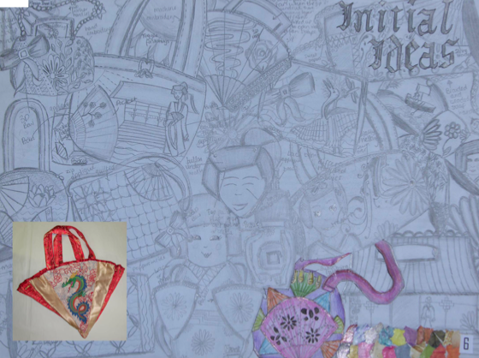
Development - Initial Ideas P5
Use an HB or 2B pencil, sketch out some early ideas.
Look at your mood board and research to inspire you. Fill up the whole sheet!
Notes:
This is the most exciting part of your coursework! The purpose is to design something new, original and exciting, a product with a difference, something that everyone will want to buy!
Let your research and design specification guide you to come up with a wide range of ideas. All ideas must be well presented and must show your thinking.
Be bold and confident; sketch freely. DO NOT use colour, just let your ideas flow. Make notes and annotate to explain your thinking.

Slide 13
Development - Design Ideas P6, P7, P8
Design Idea 1
Design Idea 2
How does it meet the Design Criteria:
My design meets the …………. specification point because………..
My design does not meet the …………. specification point because……..
How does it meet the Design Criteria:
My design meets the …………. specification point because………..
My design does not meet the …………. specification point because……..
Notes:
You must now firm up your ideas and present 6-8 realistic design ideas (use 2-3 A3-sheets), including colour, front and back views, inside views, measurements, decorative details and clear annotation. Remember the design principles of shape, style, colour, pattern, balance and proportion and present your work in a unique way.
You must evaluate each design idea against the design specification!

Slide 14
Development - Review of Design Ideas P9
Design Ideas | Design Criteria met | Design Criteria not met | Design Criteria partly met | Changes I can make to ensure all specification criteria met | Feedback from others
Design Idea 1 | The function does what is intended because ……. | - The ergonomics of the product because …….. | - The style has been partially met because…. | I can try to change…. | I like this product because….. I would buy this product because….
Design Idea 2 | The function does what is intended because ……. | - The ergonomics of the product because …….. | - The style has been partially met because…. | I can try to change…. | I like this product because….. I would buy this product because….
Design Idea 3 | The function does what is intended because ……. | - The ergonomics of the product because …….. | - The style has been partially met because…. | I can try to change…. | I like this product because….. I would buy this product because….
Design Idea 4 | The function does what is intended because ……. | - The ergonomics of the product because …….. | - The style has been partially met because…. | I can try to change…. | I like this product because….. I would buy this product because….
Design Idea 5 | The function does what is intended because ……. | - The ergonomics of the product because …….. | - The style has been partially met because…. | I can try to change…. | I like this product because….. I would buy this product because….
Design Idea 6 | The function does what is intended because ……. | - The ergonomics of the product because …….. | - The style has been partially met because…. | I can try to change…. | I like this product because….. I would buy this product because….
Notes:
You must evaluate each design idea against the design specification!

Slide 15
Planning Development P10
So far in my research I have looked at……..
This has helped me…….
I need to look at…………….
because this will help me
I would like to experiment with …………
What needs developing | What I need to achieve | What I need to do
Shape, style, size | I need to try to… | I will model.…..
Ergonomics of my product | I need to try to… | I will look at…
Prototype | I need to try to… | I will make…
Construction methods | I need to try to… | I will research….
Material choice | I need to try to… | I will research…
Components choice | I need to try to… | I will look at…
Health and Safety | I need to try to… | I will look at…
Packaging | I need to try to… | I will research…
Environmental issues | I need to try to… | I will consider….
Public opinion market research | I need to try to… | I will ask others ….
Use this space to include some initial thought showers of development work needed eg Mind Map for Construction, shape & style, materials;, components
Development Plan
Notes:
Development is the most important and time-consuming part of your task! You will have 6-8 hours to carry out practical trials and it is therefore important to plan every stage in detail.
You need to develop the shape, style, size, colour, choice of material and construction techniques for your product by carrying out some practical trials. Present your work over 6-8 A3-sheets

Slide 16
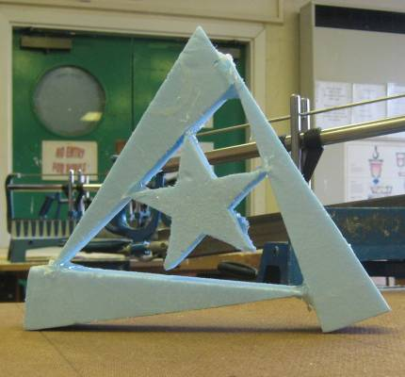
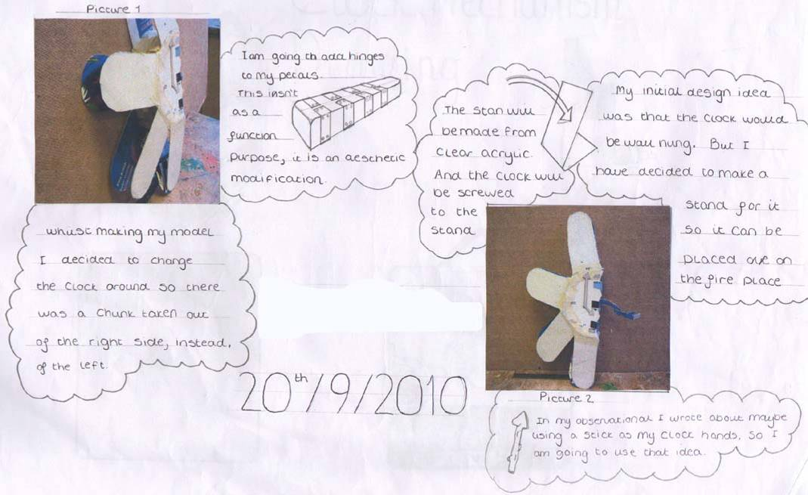
Development of Shape, Style and Size P11
Size
Include sketches from yourself and your peers to show different styles / shapes etc. of your chosen idea
This shape works well because…..
This shape could be improved by……
Shape & Style
Make a paper model / prototype of the product and mount it / a photograph if it is to big, in this space.
This model has been
successful because…
This model could be
improved by……
Ergonomics & Anthropometric Data
Add some information about which information and anthropometric data (human measurements that you will need) to make your product.
I will need to find out the measurements of:
Hands/ arm length/ height/ shoulder width because this will help me….
Notes:
Look at the design ideas you’ve come up with. You will have a favourite. Go through the design specification criteria to see if it matches what you have designed.
1. Sketch your best idea, making modifications and trying different styles. Include teamwork, where your peers modify the shape and style of your idea!
Make a paper model/prototype of the product to check that the size is right.
Make a model or template.

Slide 17
Help – Section 2 -Development of Design Proposal – 32 Marks
PAGE 12 – Development of Design Features
Look back at your mood board and the colours on it to guide your thinking. You might want to gather colour palette cards, try different colour ways, using software packages on the computer, or experiment with paint. Evaluate your colour choice; ask others what they think.
Look back at your mood board and design ideas for design features and inspiration you’ve included. Produce small samples to see to work out the best decorative techniques to use for your design idea and test it on fmaterials you are likely to use! Evaluate each technique, explaining what the process has involved, what the results are like and if and where your will use it on your own work.
PAGE 13 – Development of Construction
It is important that you trial certain construction techniques to ensure the best methods for construction are used to create a high quality product.
PAGE 14 – Development of Materials and Components
You must choose the most suitable materials and components for your product. Carry out some further research and tests so that you can make informed choices.
Public opinion, costing, sustainability and after care are important issues to consider at this stage.

Slide 18
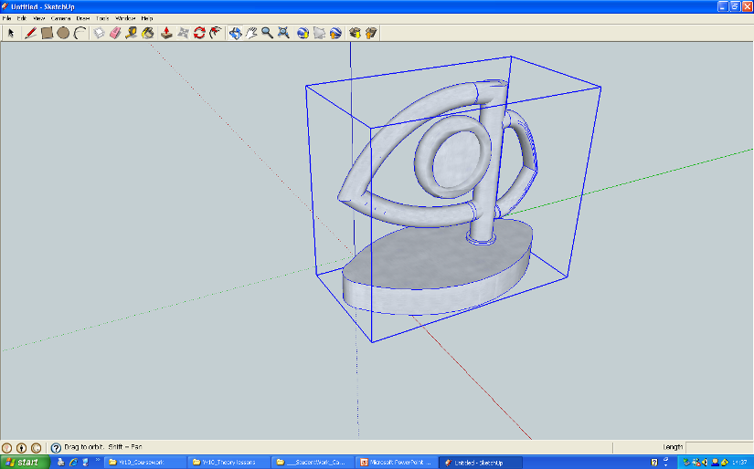
Development of Design Features P12
Photograph your your model and reflect on it in this space
This model was successful because……
This model could be improved…………..
Modelling Idea 1
Modelling Idea 2
Photograph your your model and reflect on it in this space
This model was successful because……
This model could be improved…………..
CAD Modelling
.
You may wish to create a CAD model in 2D (e.g. 2D Design) or, better still, 3D (e.g. Google Sketchup)– SHOW SCREENSHOTS OF THIS CAD MODEL TOO.
Photograph you’re your model and reflect on it in this space
This model was successful because……
This model could be improved…………..
Modelling Idea 3
This model was successful because……
This model could be improved…………..
Notes:
Look back at your mood board and the colours on it to guide your thinking. You might want to gather colour palette cards, try different colour ways, using software packages on the computer, or experiment with paint. Evaluate your colour choice; ask others what they think.
Look back at your mood board and design ideas for design features and inspiration you’ve included. Produce small samples to see to work out the best decorative techniques to use for your design idea and test it on fabrics you are likely to use! Evaluate each technique, explaining what the process has involved, what the results are like and if and where your will use it on your own work.

Slide 19
Development of Construction P13
Insert samples of construction techniques that you will use in your final product, as well as a prototype if you haven’t done so earlier on
I have tried using the ……………… technique because………….
It worked well because……
It could be improved by……..
Insert samples of manufacturing processes that you will use in your final product.
What machinery will you use to make your product?
I have used ………….. machine/ tool to do ……….
This worked successfully because…….
This did not work successfully because….
What quality checks will you carry out?
I will check the quality when using ………….
by …………………
e.g. measuring accurately using a ruler.
Using the vice to clamp work securely.
Manufacturing Processes
Construction Techniques
Quality Control Checks
Notes:
It is important that you trial certain construction techniques to ensure the best methods for construction are used to create a high quality product.

Slide 20
Development of Materials & Components P14
Material / Component sample | Properties | Cost | Sustainability | Public Opinion
 | Durable, Lightweight flexible | - | This material is sustainable because.... It can be recycled, it is made from renewable energy sources | I think this material would work well…..
Conclusion
Notes:
You must choose the most suitable materials and components for your product. Carry out some further research and tests so that you can make informed choices.
Public opinion, costing, sustainability and after care are important issues to consider at this stage.

Slide 21
Help – Section 2 -Development of Design Proposal – 32 Marks
PAGE 15 – Sustainability and Social, Cultural, Moral and Safety Issues
Sustainable refers to products that have been designed to have a lesser impact on the environment and improve the working conditions and economic security of those making the product. Responsible designers modify their ideas to ensure sustainability issues are taken into consideration when making decisions about choice of materials and methods of manufacture.
Design Thinking; Sourcing and selecting fabric and components; Recycled components used; Product Lifecycle; After care; Mass Manufacturing in factories; Location of manufacturing; Fairtrade; Labelling
Social, moral, ethical, cultural and safety issues are of concern to both manufacturing companies, their employees and consumers buying their products. Relate it to your own product.

Slide 22
Development: Sustainability P15
Social, Moral, Ethical, Cultural and Safety Issues
Sustainability
Moral & Cultural Issues
My finished design could be considered to be Sustainable because ….
My finished design is not Sustainable because ….
My finished design could be made more Sustainable by ….
Some products might not be suitable for certain markets because of moral, cultural or religious reasons
E.g. your clock might be based on Pop Art; Pop Art is closely associated with American culture and it might not sell very well in countries that are occupied by American forces.
Add notes on your page where you think it is appropriate.
The moral issues that effect my product are……. I could try to adapt my product by…….
The cultural issues that effect my product are……. I could try to adapt my product by…….
Social Issues
Are you designing for a particular target group e.g. the elderly, people with special needs, children/young people? If yes, explain how and why
Costing – adjusting to
fit it in with affordability for target market
Are you designing a product that will not date/go out of fashion?
The social factors that will impact my product are…
Safety Issues
Health and safety of workers making the product and consumers using it. E.g. safe use of machinery, protective clothing worn, components sew on securely, and not easily breakable
Ensuring no laws are broken during manufacture.
If my product was being manufactured I would consider…….
Notes:
Sustainable refers to products that have been designed to have a lesser impact on the environment and improve the working conditions and economic security of those making the product. Responsible designers modify their ideas to ensure sustainability issues are taken into consideration when making decisions about choice of materials and methods of manufacture.
Design Thinking; Sourcing and selecting material and components; Recycled components used; Product Lifecycle; After care; Mass Manufacturing in factories; Location of manufacturing; Fairtrade; Labelling
Social, moral, ethical, cultural and safety issues are of concern to both manufacturing companies, their employees and consumers buying their products. Relate it to your own product.

Slide 23
SECTION 2: DEVELOPMENT OF DESIGN PROPOSALS (including modelling)
0-5 | 6-11 | 12-18 | 19-25 | 26-32
ideas are lacking in imagination with minimal development or further research | Ideas show some variation in approach or concept | Design ideas show some degree of creativity and further development | Imaginative ideas demonstrating a degree of creativity, which are further developed to take account of ongoing research | Imaginative and innovative ideas have been developed, demonstrating creativity, flair and originality. Further developments made to take account of ongoing research
Little evidence of a logical approach being adopted, with no indication of planning | A limited design strategy, with minimal planning, is evident | An appropriate design strategy, with some evidence of planning, adopted for some aspects | An appropriate design strategy, with evidence of planning, adopted for most aspects | A coherent and appropriate design strategy, with clear evidence of a planned approach, adopted throughout
Development work shows little consideration of social, moral, environmental and sustainability issues | Some consideration taken of social, moral, environmental and sustainability issue in development of design solutions | Developments of design solutions are influenced to some extent by factors relating to social, moral, environmental and sustainability issues | Development of design proposals take into account the main aspects relating to a variety of social, moral, environmental and sustainability issues | The implications of a wide range of issues including social, moral, environmental and sustainability, are taken into consideration and inform the development of the design proposals
Basic development work undertaken using a limited range of techniques | Development work is lacking in detail but makes reference to a number of techniques and modelling (including CAD where appropriate) | Adequate development work achieved through working with a range of techniques and modelling (including CAD where appropriate) | good development work achieved through working with a variety of techniques and modelling (including CAD where appropriate) | Excellent development work through experimentation with a wide variety of techniques and modelling (including CAD where appropriate) in order to produce a final design solution
Materials/ingredients and components selected with little regard to their working properties | Materials/ingredients and components selected with limited regard to their working properties | Materials/ingredients and components selected with some regard to their working properties | Appropriate materials/ingredients and components selected with regard to their working properties | Appropriate materials/ingredients and components selected with full regard to their working properties
Produced a simple product/manufacturing specification which is general in nature | Limited product/manufacturing specification which reflects most obvious features of analysis | Product/manufacturing specification reflects most aspects of the analysis | Product/manufacturing specification is complete and reflects key aspects of the analysis undertaken | Fully detailed and justified product/manufacturing specification taking full account of the analysis undertaken

Slide 24
HELP – Section 3 - Making – 32 Marks
LOTS OF PHOTOGRAPHS!
PAGE 16 – Costing & Manufacturing Specification
Manufacturing Specifications are used in the industry to show details of the design in the form of a working drawing; suitable materials to use; to describe the stages of manufacture in the form of a flow chart; to specify materials & components needed to make the product. It also includes important information about health and safety and construction techniques. If the product is to be made repeatedly, it ensures each product is identical and made to a set standard.
PAGE 17 – Production Record
Production Records are helpful for designers in evaluating their work, writing up manufacturing specifications for new designs and to suggest modifications. Keep a record of the practical work you carry out every lesson and complete the chart on the slide above.
to help you complete the last two columns in the chart on Quality control and Risk Assessments in the industry.
PAGE 18 - Photographic evidence of manufacture
This will give the examiner a visual idea of both processes as well as Quality Control procedures you’ve applied throughout.

Slide 25
Costing & Manufacturing Specification P16
Product Name and Description:
Working Drawing:
Sketch and annotate your working drawing in HB or 2B pencil in this space. Annotate clearly, showing measurements, construction techniques etc.
Insert your cutting list and calculate the cost of all the materials and components needed for your final piece of practical work
Cutting List & Costing
End Product
Insert photos of the final product here
Production Process
Insert your industrial /method of making here
Include photos of processes (this might overflow onto a next A3 sheet depending on the complexity of your product and process of making)
Completion Date: Delivery Date
Notes:
Manufacturing Specifications are used in the industry to show details of the design in the form of a working drawing; suitable materials to use; to describe the stages of manufacture in the form of a flow chart; to specify materials & components needed to make the product. It also includes important information about health and safety and construction techniques. If the product is to be made repeatedly, it ensures each product is identical and made to a set standard.

Slide 26
Production Record P17
Date | Work carried out | Modifications How have you altered this stage from original plans? | How would this been carried out in industry? | Quality control checks | Risk Assessment / Health and Safety issues
27.02.15 | Marked out and measured out all the holes to be drilled for the shelf screws | I had to put them further apart to balance | This would be carried out by… | Checking the accuracy of the measurements. | Risk of injury from the pillar drill
Notes:
Production Records are helpful for designers in evaluating their work, writing up manufacturing specifications for new designs and to suggest modifications. Keep a record of the practical work you carry out every lesson and complete the chart on the slide above.
to help you complete the last two columns in the chart on Quality control and Risk Assessments in the industry.

Slide 27
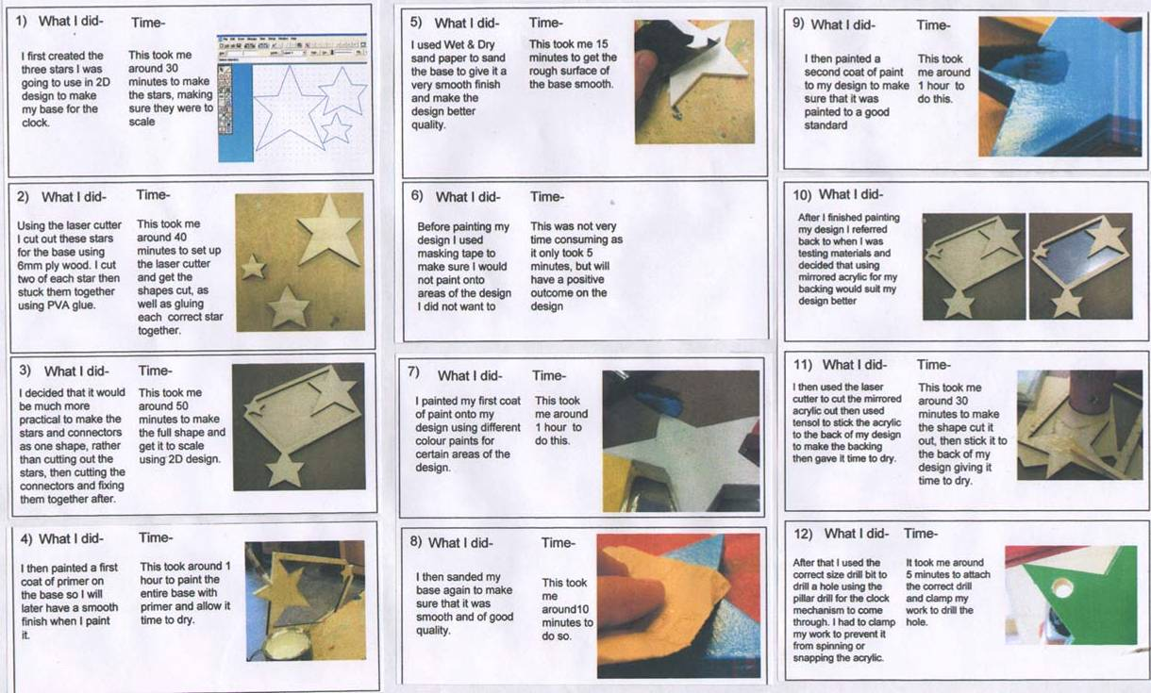
Photographic evidence of Manufacture P18
Insert a photo diary of the making of your product.
Notes:
This will give the examiner a visual idea of both processes as well as Quality Control procedures you’ve applied throughout.

Slide 28
SECTION 4: TESTING AND EVALUATION
0-2 | 3-5 | 6-8 | 9-12
Minimal testing and evaluation throughout the designing and making process | Evidence of some testing and evaluation leading to the production of the final outcome | Appropriate testing and evaluation evident throughout the designing and making process | Detailed testing and evaluation as appropriate throughout the designing and making process taking account of client/user or third party opinion
Limited or no testing of final outcome against the design criteria and/or the product/manufacturing specification | Some evidence of testing against the design criteria and/or the product/ manufacturing specification | Most aspects of the final outcome have been tested against the design criteria | All aspects of the final outcome have been tested against the design criteria and/or the product/manufacturing specification
Limited mention of some improvements or modifications that could be made to the product | Some improvements or modifications to product suggested | Evaluate and justify the need for improvements or modifications to the product | Evaluate and justify the need for modifications to the product and consideration given as to how the outcome might need to be modified for commercial production

Slide 29
SECTION 3: MAKING
0-5 | 6-11 | 12-18 | 19-25 | 26-32
Final outcome is incomplete or represents an undemanding level of making/ modelling/finishing skills | Final outcome is largely complete and represents a basic level of making/ modelling/finishing skills | Final outcome shows good level of making/modelling/finishing skills | Final outcome shows very good level of making/modelling/finishing skills | Final outcome(s) shows a high level of making/modelling/finishing skills and accuracy
Used materials, components and equipment safely under close supervision | Used materials, components and equipment correctly and safely (including CAM if appropriate) | Used appropriate materials, components, equipment and processes correctly and safely (including CAM) | Selected and used appropriate tools, materials and/or technologies including, where appropriate, CAM correctly and safely | Selected and used appropriate tools, materials and/or technologies including, where appropriate, CAM correctly, skillfully and safely
Worked with some assistance to produce outcome of limited demand | Some aspects of outcome are demanding | Parts of outcome show high levels of demand | Outcome demonstrates a high level of demand | Worked independently to produce a rigorous and demanding outcome
There is limited evidence of any quality control and levels of accuracy are minimal | Some evidence of limited quality control applied throughout the process | Applied quality control checks broadly but superficially | Quality control checks applied in the manufacture of the product | Quality controls are evident throughout the project and it is clear how accuracy has been achieved
The outcome has significant weaknesses which limit its suitability for the target market | The outcome has some weaknesses which limit its suitability for the target market | The outcome requires further development in order to be suitable for the target market | The outcome is suitable for the target market and could be commercially viable with further development | The outcome has the potential to be commercially viable and is suitable for the target market

Slide 30
Help – Section 4 –Testing & Evaluation (12 Marks)
PAGE 19 –Testing & Evaluation
Testing and Evaluation of new products are vital.
1. Comparing your product with a similar commercial product
Getting Public Opinions about your product.
Modelling /Testing the product in the environment you will use it.
PAGE – Testing and Evaluating against the Specification & further modification
Testing and Evaluation of new products are vital.
Testing against the Design Specification
2. Writing a full Manufacturing Report and conclude on all your test results. This should also include suggestions for modifications to improve the quality of the product as well as modifications to make it suitable for commercial production.

Slide 31
Testing and Evaluation P19
Public Opinion on my product
Comparison with Commercial Product
Photo of Public member | Comment | Mark out of 10
 | I think that this product works well because… I am not keen on the … of this product because
 | I think that this product works well because… I am not keen on the … of this product because
 | I think that this product works well because… I am not keen on the … of this product because
 | I think that this product works well because… I am not keen on the … of this product because
 | I think that this product works well because… I am not keen on the … of this product because
Compare your product with a similar product on the market. Include photographs of both your own product as well as a similar shop bought product and describe and compare the products for cost, skills used, features, sustainability, fabric and components used etc.
Modelling the Product
Take photographs of the product eg. Interior products should be photographed in the environment it could be used in. Evaluate the suitability and suggest modifications.
Notes:
Testing and Evaluation of new products are vital.
1. Comparing your product with a similar commercial product
Getting Public Opinions about your product.
Modelling /Testing the product in the environment you will use it.

Slide 32
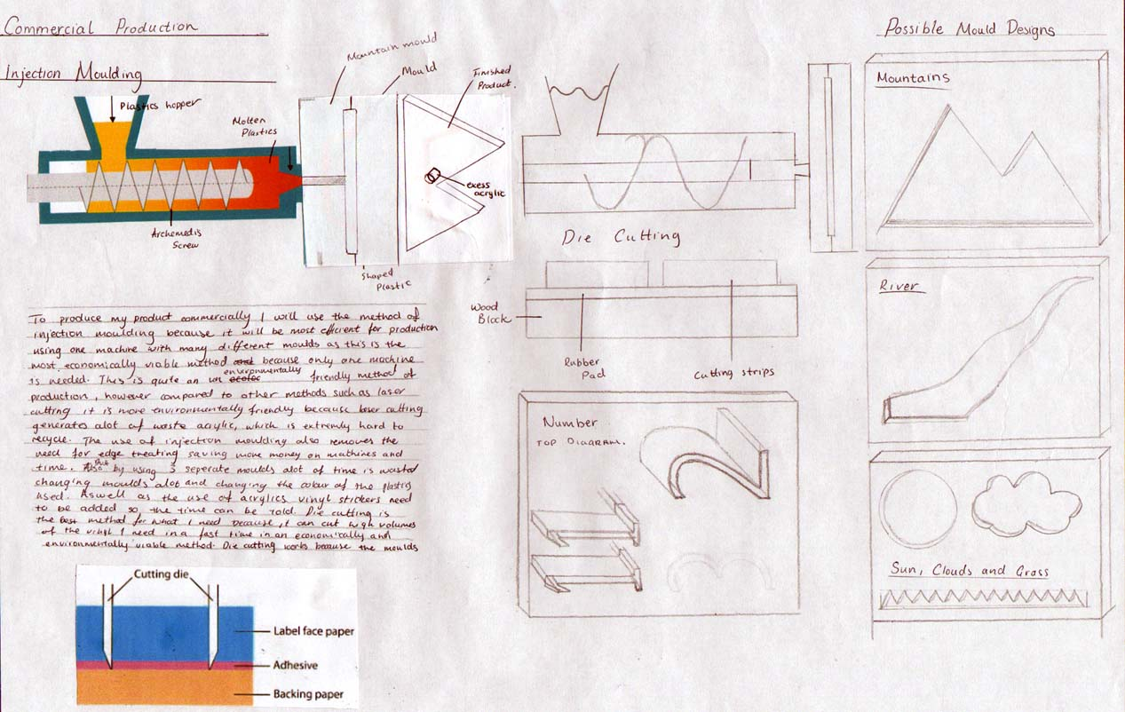
Testing & Evaluating against the Specification P20
Testing against the Specification
Manufacturing Report
Write a detailed manufacturing report
Specification Criteria | Test | Result
Size to be minimum of 400mm in length | 3 people testing that the product can reach over to the back | This test was successful because the 3 people testing could comfortable reach.
Notes:
Testing and Evaluation of new products are vital.
Testing against the Design Specification
2. Writing a full Manufacturing Report and conclude on all your test results. This should also include suggestions for modifications to improve the quality of the product as well as modifications to make it suitable for commercial production.

Slide 33
SECTION 5: COMMUNICATION
0-2 | 3-4 | 5-6
Design folder shows excessive duplication of information and a lack of brevity and focus resulting in irrelevant content | Design folder shows some skill in choice of material for inclusion but includes some irrelevant content | Design folder is focussed, concise and relevant and demonstrates an appropriate selection of material for inclusion
ideas and decisions communicated at a simplistic level with a limited grasp of the concepts involved and a limited use of technical vocabulary | Most decisions communicated with some clarity and with some use of technical language | All decisions communicated in a clear and coherent manner with appropriate use of technical language
Numerous errors in grammar, punctuation and spelling | There are a small number of errors in grammar, punctuation and spelling | The text is legible, easily understood and shows a good grasp of grammar, punctuation and spelling
Grade Boundaries: these are approximate as they change yearly (you need to be well within the boundary to be certain of earning that grade) | A* | 83 |  | B | 65 |  | D | 46 |  | F | 28
 | A | 74 |  | C | 55 |  | E | 37 |  | G | 18

Slide 34
HELP - KEY WORDS - DT LITERACY
Aesthetics :
Materials:
Appeal Professional Look Finish Texture Matt Shiny
Colourful Bright Attractive Curved Boxy Modern Antique Angled Reflective Organic Contrasting colours Design Inspired by…
Acrylic HIPS (High Impact Polystyrene) Hard wood
Oak Soft wood Pine Birch MDF (Medium Density Fibreboard) Ply wood Glue Acrylic Rod Aluminium Rod
Fabric Textiles Screws Fixtures
Function :
Safety:
Easy to use Working Simple Safe Fit for purpose component Suitability
Shape Sharp edges Warning signs Suitability ages Target market Instructions Advice
Size:
Small Large Feature Hand Held Ergonomics Packaged Transportable Protect
Cost of materials Cost of manufacture Cost to retailer Cost to consumer Cost to replace parts Cost to maintain Cost to replace
Cost:
Weight:
Green Issues:
Ergonomics Anthropometrics Size Materials Transport Accuracy User Safety
Reduce Re-used Re-Cycled Rethink Renewed Repaired
Environmentally friendly Material Product Lifecycle
Durability:
.
Manufacture:
Life cycle How long should it last? Fragile Strong Durable Flexible Shatter proof Cost Transport Protect Preserve
Machine Hand Tools CAD (computer Aided Design) CAM (Computer Aided Manufacture) Template Quality Finish Paint Quality control Testing
Target Market, Design Movement, Inspired by.., Developed, Development, Specification, Analysis, Product, Testing, Quality Control, Manufacture, Research, lamp component,

Slide 35
Development
Provided little evidence. | G
Used one idea and developed it a little to produce a final design | F
Used ideas and knowledge and show some ways to produce a final design answering most of the specification. | E
Used ideas and knowledge in a range of ways to develop a final design answering the specification | D
Used ideas and knowledge in several ways (including CAD where applicable) to produce a detailed final design answering the specification | C
Used a variety of techniques (including CAD where applicable) and knowledge of working properties of materials/components/ingredients to produce a detailed final design answering the specification. | B
Used a wide range of techniques (including CAD where applicable) and knowledge of working properties of materials/components/ingredients, to produce a detailed final design answering the specification. | A
Planning
Attempted some forward planning. | G
Produced a simple plan for making one part of the proposed design. | F
Produced simple plans for making more than one part of the proposed design. | E
Planned an order of tasks for making the proposed design. | D
Planned a mainly correct and workable order of tasks for making the proposed design. Planning evident in some parts of folder. | C
Planned a correct and workable order of tasks for making the proposed design. Planning evident in most aspects of folder. | B
Planned a correct order of tasks for making the proposed design which shows where, why and how production decisions were made. Planning evident throughout folder. | A
Graphics Skills
Used very limited communication, graphical and ICT skills. Spelling and grammar mistakes throughout. | G
Used limited communication, graphical and ICT skills. Mistakes in spelling and grammar. Very basic use of technical language. | F
Used some suitable communication, graphical and ICT skills to express ideas. Few technical terms used. | E
Used suitable communication, graphical and ICT skills that express ideas. Some technical language used. | D
Used a range of communication, graphical and ICT skills that express ideas. Technical language used correctly. | C
Used a suitable range of communication, graphical and ICT skills that express ideas to others effectively. Correct technical terms are used in a clear and concise way. | B
Used a wide range of communication, graphical and ICT skills skilfully that express ideas to others usefully and accurately. Correct use of relevant technical language in a clear and grammatical way. | A
Evaluation
Attempted to evaluate part of the practical work. | G
Attempted to test and evaluate part of the practical work. | F
Tested and evaluated some parts of the practical work | E
Tested and evaluated most parts of the practical work and made some suitable changes | D
Tested, evaluated and modified the practical work during designing and making where necessary against design criteria. | C
Tested, evaluated and modified the practical work during designing and making process where necessary, including feedback from Client/User with explanations. | B
Tested, usefully evaluated and successfully modified work throughout the designing and making process where necessary including taking account of Client/ User/ Third party opinion and adapting final design for manufacture. | A

Slide 36
Research
Gathered information from one place. | G
Gathered information from more than one place | F
Gathered information from some different places | E
Gathered information from several suitable places | D
Gathered information from a variety of relevant places and put it in order | C
Gathered a well ordered and relevant range of suitable information from a variety of places. | B
Gathered a well organised and relevant range of suitable information from a wide variety of places | A
Analysis
Provided little evidence | G
Analysed a part of the chosen task and some research information | F
Analysed some parts of the chosen task and most research information | E
Analysed most parts of the chosen task and all of the research including products. | D
Analysed the chosen task in some detail and all of the research including products/systems. | C
Analysed the chosen task and context thoroughly and all of the research including products/systems. | B
Analysed the chosen task and context and all of the relevant research thoroughly, logically and effectively including products/systems. | A
Specification
Stated one important feature of the proposed design | G
Stated more than one important feature of the proposed design including User. | F
Stated the main features of the proposed design, Target market/User and making, using the task analysis | E
Stated most features of the proposed design, Target market/User and making, using the task analysis | D
Stated all the features of the proposed design, Target market/User and making, using the task analysis. | C
Stated with details, all the features of the proposed design and identified Target market/User, closely using the task analysis and suggested manufacturing techniques. | B
Stated with details and reasons, all the features of the proposed design and target market/user’s profile, closely using the task analysis and specific manufacturing techniques. | A
Ideas
Produced one idea | G
Produced at least two ideas based on some statements in the specification | F
Produced at some varied ideas based on most statements in the specification | E
Produced at some ideas showing some creativity, based on all the statements in the specification | D
Produced a range of ideas, showing creativity, based on all the statements in the specification | C
Produced a wide range of creative, innovative ideas based on all the statements in the specification | B
Produced a wide range of original, creative, innovative ideas showing some flair based on all the statements in the specification | A

Slide 37
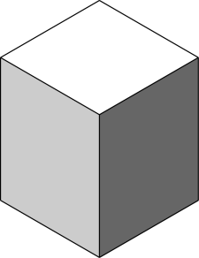
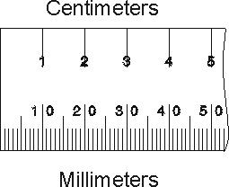
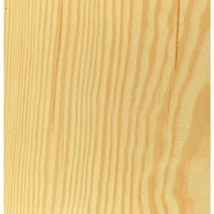
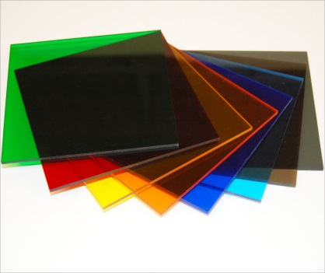

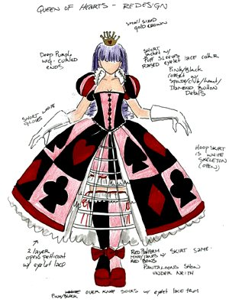
2 Dimensions to 3 Dimensions
Pine
Soft wood
Acrylic
Plastic
Target Market – Who is it for?
Development – How have you improved it?
Explain – Annotate
C – COST – How does it cost to make or sell? Where is it sold? Is it value for money?
A – AESTHETICS – What does it look like? Is it appealing? Colour? Pattern? Shape?
F – FUNCTION – What does it do? Is it appropriate?
E – ERGONOMICS – Is it comfy to use? Does it fit the human body?
Q – QUALITY – Is it well made?
U – USER – Who is it for? Who uses it?
E – ENVIRONMENT – Is it recyclable? Is it good for the planet?
Annotate and Explain
Colour
Shape Texture Size Weight Style

