Slide 2
Sketching Techniques - Drawings must be 3D -Use wire frames to make 3D crates - Add colour and tone – but less is more Remember the light source will come from one direction -Add thick and thin lines to show depth. Drawings must be fully annotated – Use the prompts below to help you:
Materials | Aesthetics | Techniques | Joining Techniques | Materials | Material Properties
Plastics: Acrylic Polypropylene HIPS (High Impact Polystyrene) Wood: MDF Plywood Pine | Smooth finish Geometric shape Curved shape Decorative feature Bright colours/ Primary colour Pastel colours Neutral colours High quality Modern design Bold, eye catching, | Vacuum Forming Fret Saw/ Coping Saw Strip Heater Belt Sander Polishing Machine Laser Cutter 2D Design – CAD/CAM Roland SX8 sticker machine CAD/CAM Filing Pillar Drill | Wood: Butt joint Corner halving joint Through housing joint Mortise and tenon joint Adhesives: Epoxy Resin Synthetic resin Knock down fittings Screws Rivets | Plastics: Acrylic Polypropylene HIPS (High Impact Polystyrene) Wood: MDF Plywood Pine | Durable Portable Lightweight Rigid Strong Elasticity

Slide 4
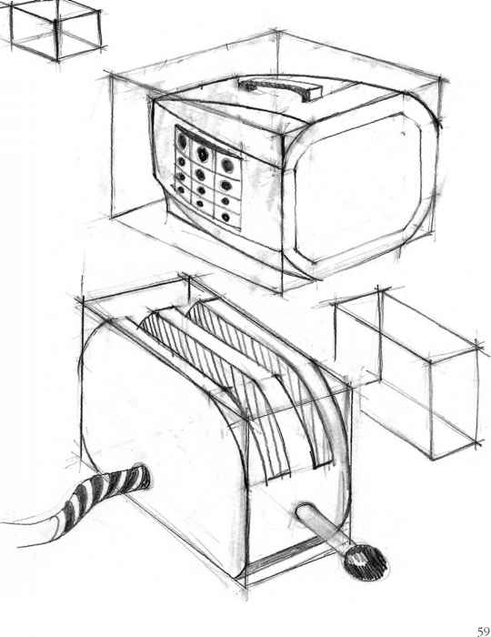
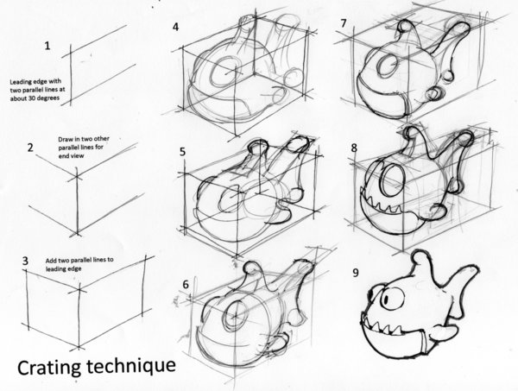
Crating Technique
-Draw a 3D wire frame
Which is the same basic
Shape of the object

Slide 5
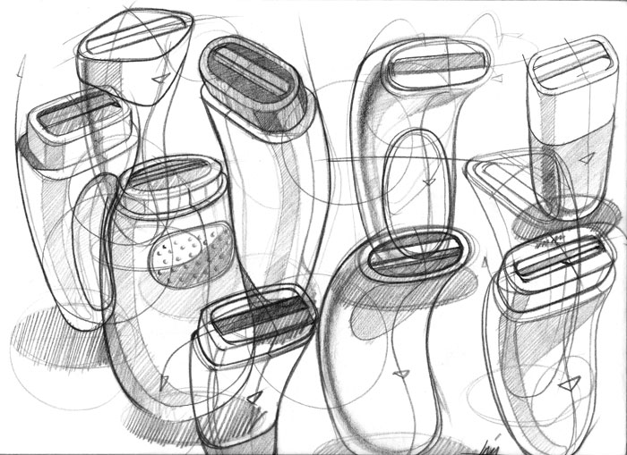

Slide 6
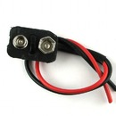
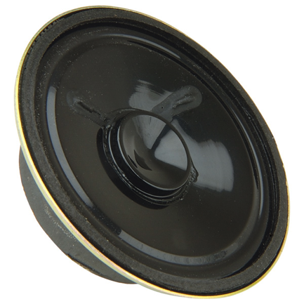
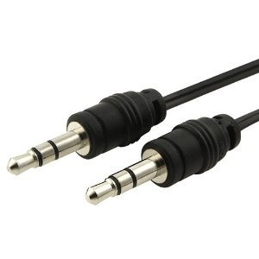
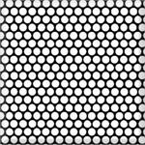
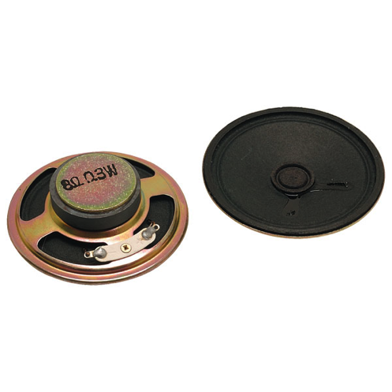
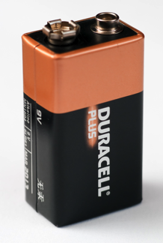
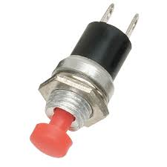
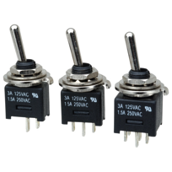
Components to draw

Slide 7
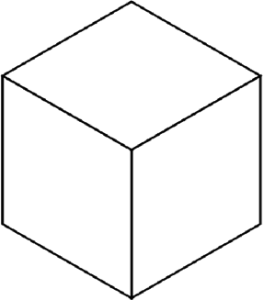
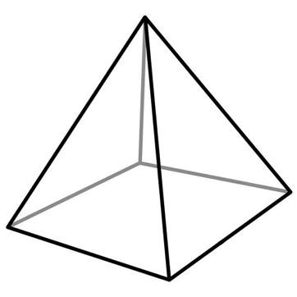
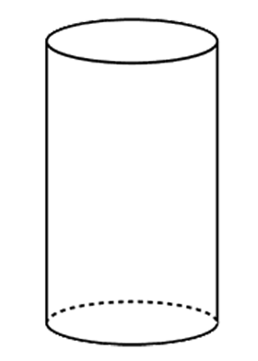
Basic 3D Shapes

Slide 8
